Slide 1
Linear Equations
Topic: Introduction to Solving Equations
EQ: How do we solve linear equations?
Mrs Stretch
Year 7

Slide 2
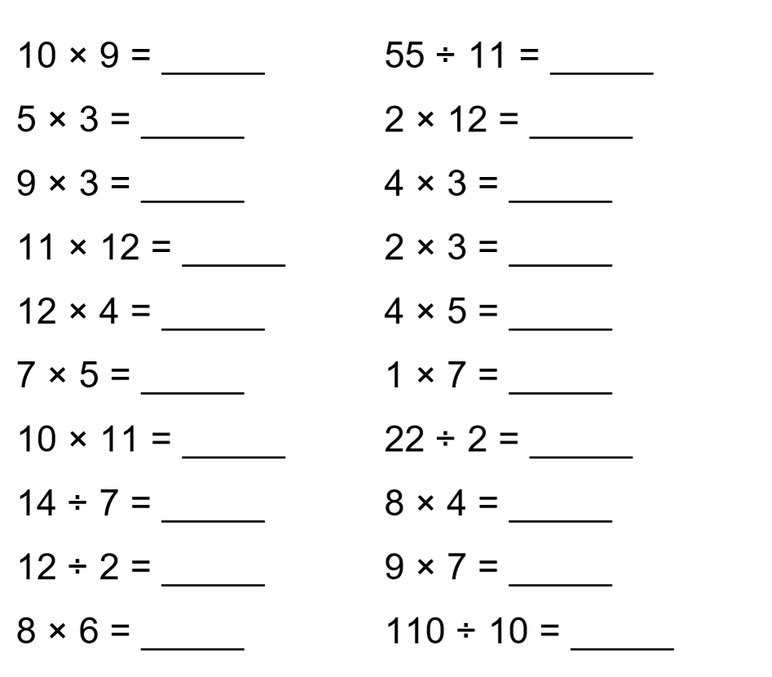

90
5
5 minutes
15
132
6
11
2
63
48

Slide 3
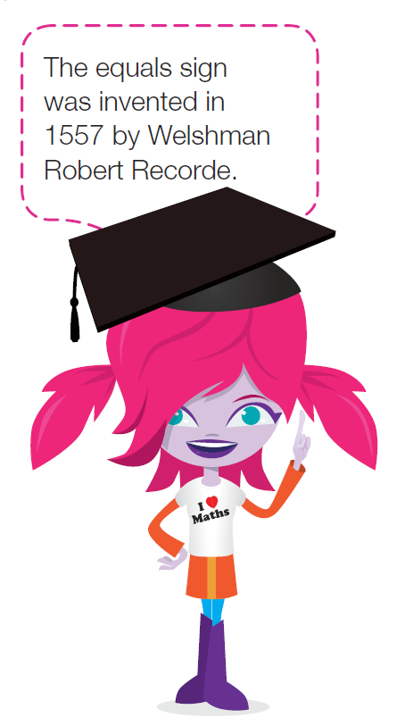
24
7
30
Introduction to Solving Equations
Date
EQ – How do we solve linear equations?
How do we solve an equation?
Solving an equation means finding the values of any variable to make the equation true.
An unknown in an equation, is a variable whose value needs to be founds in order to make the equation true
One methods of solving equations is by inspection or trial and error.

Slide 4
Think – Pair - Share
How did you solve the following equations?
____ + 6 = 10
5 x ____ = 25
Write down the method you used to solve the following equations.
Notes:
Kids will just know that 4 + 6 is 10. they wont know to work backwards

Slide 5
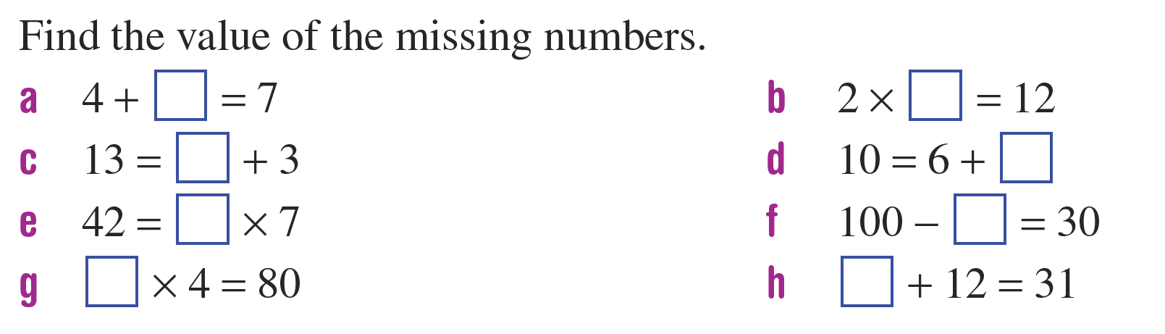
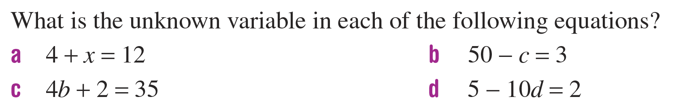
Practice
Use the method you used just then to solve the following equations
Challenge Questions

Slide 6
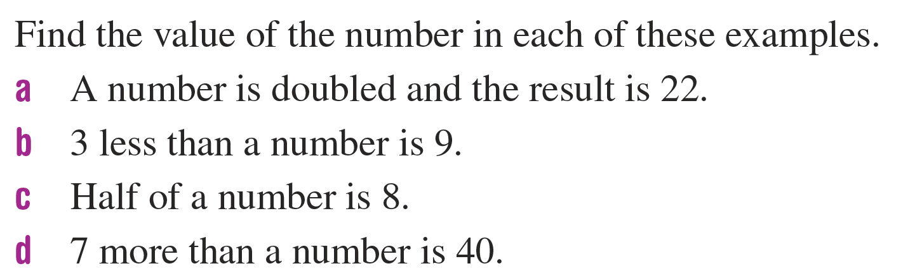
Some more Practice

Slide 7


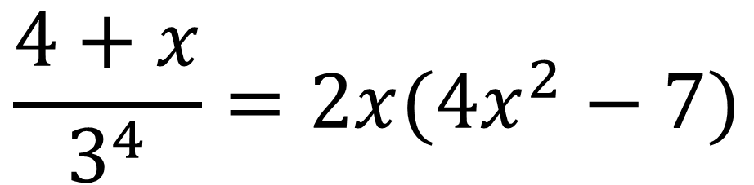
24
7
30
Introduction to Solving Equations
Date
EQ – How do we solve linear equations?
How do we solve an equation?
What happens if we get given an equation like this:
$$\frac{4+x}{3^{4}}=2x(4x^{2}−7)$$

Slide 8
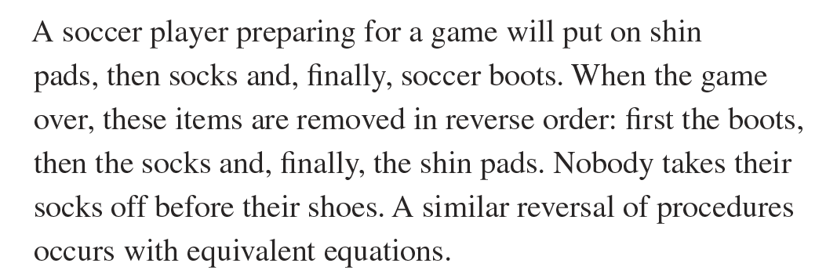

24
7
30
Introduction to Solving Equations
Date
EQ – How do we solve linear equations?
How do we solve an equation?
It’s called Backtracking

Slide 9
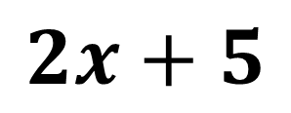
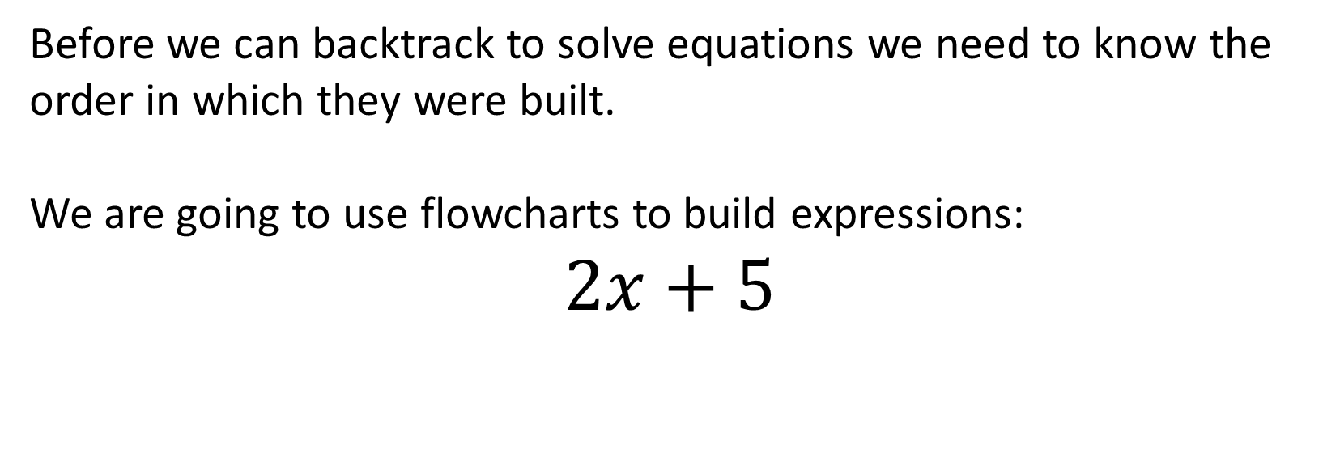
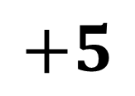
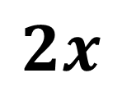
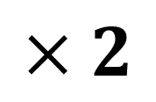
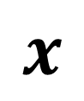
24
7
30
Introduction to Solving Equations
Date
EQ – How do we solve linear equations?
How do we build equations?
Before we can backtrack to solve equations we need to know the order in which they were built.
We are going to use flowcharts to build expressions:
$$2x+5$$
What is the first thing that is happening to x?
$$×2$$
$$+5$$
$$x$$
$$2x$$
$$2x+5$$

Slide 10
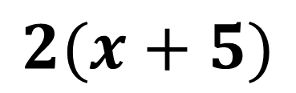

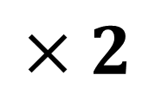
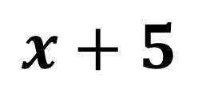
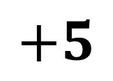
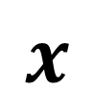
24
7
30
Introduction to Solving Equations
Date
EQ – How do we solve linear equations?
What is the first thing that is happening to x?
How do we build equations?
$$2(x+5)$$
$$+5$$
$$×2$$
$$x$$
$$x+5$$
$$2(x+5)$$

Slide 11
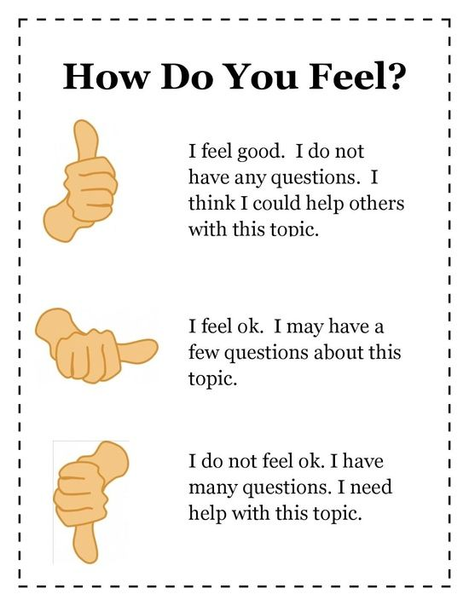

Slide 12
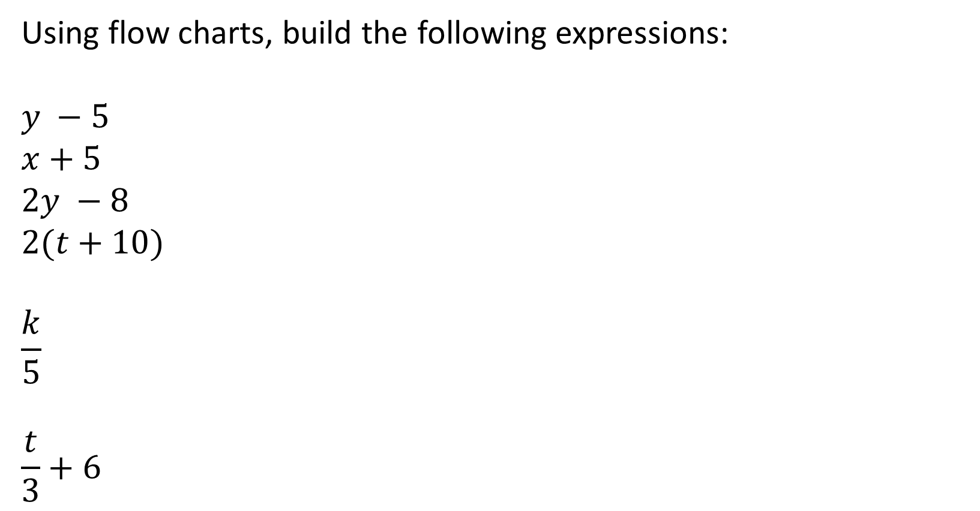
Task
Using flow charts, build the following expressions:
$$y −5$$
$$x+5$$
$$2y −8$$
$$2(t+10)$$
$$\frac{k}{5}$$
$$\frac{t}{3}+6$$

